Slide 1
The guts of MixSIAR
Brian Stock

Slide 2
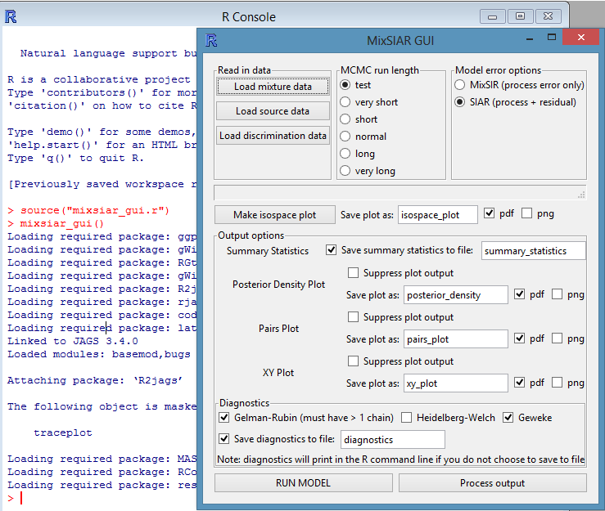
Mix data
Random effects
Fixed effects
Continuous effect
Individuals as RE
Hierarchy / nested
Source data
Source by factor
Concentration dependence
“Raw” or “means”
MCMC parameters
Error structure

Slide 3
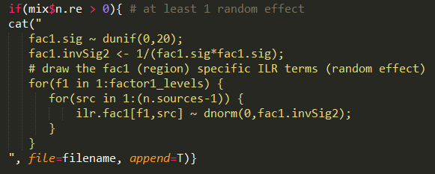
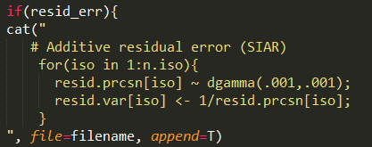
Inside the black box
JAGS
R
User options
write_JAGS_model.r

Slide 4
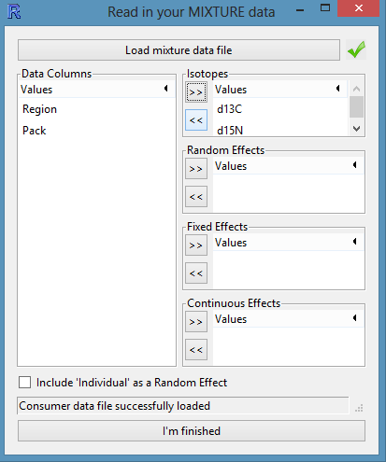
Mix data options
Random effects
Fixed effects
Continuous effect
Individuals as RE
Hierarchy / nested

Slide 5
1) random and 2) fixed effects
Previously (w/o random or fixed effects):
Assumes that all consumers have the same diet
p = [20%, 50%, 20% 10%]

Slide 6
1) random and 2) fixed effects
Consumer δ¹³C

Slide 7
1) random and 2) fixed effects
N(m,var)
Consumer δ¹³C

Slide 8
1) random and 2) fixed effects
Consumer δ¹³C

Slide 9
1) random and 2) fixed effects
N(m₁,var₁)
N(m₂,var₂)
N(m₃,var₃)
Consumer δ¹³C

Slide 10
1) random and 2) fixed effects
N(m_{pop},var_{group})
Consumer δ¹³C

Slide 11
1) random and 2) fixed effects
N(m_{pop},var_{group})
m_{group} ~ N(m_{pop},var_{group})
X_{ind} ~ N(m_{group},var_{ind})
Consumer δ¹³C

Slide 12
1) random and 2) fixed effects
Semmens et al. (2009)

Slide 13
1) random and 2) fixed effects
Random effects:
Suspect levels come from global/overall distribution
Interested in global/overall as well as specific levels
With multiple RE, can get info on relative importance of each
At least 3 levels (ideally more)
Fixed effects:
Suspect levels are unrelated
Interested in specific levels only, not a broader distribution
Only 2 (or 3) levels
Note: SIAR can run one fixed effect (“group”)

Slide 14
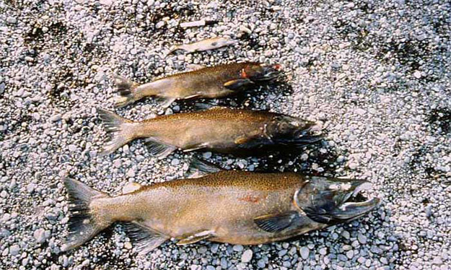
3) continuous effect
δ_{c} = p₁ s₁ + p₂ s₂ + . . . p_{i} s_{i}
p₁ = B₀ + B₁*Predictor_{c}
Francis et al. (2011)

Slide 15
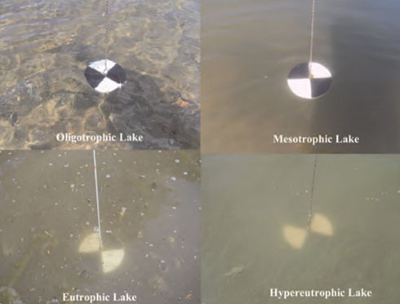
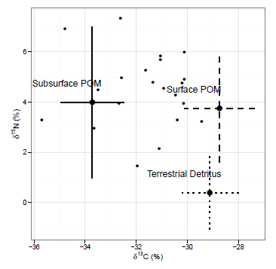
3) continuous effect
Francis et al. (2011)

Slide 16
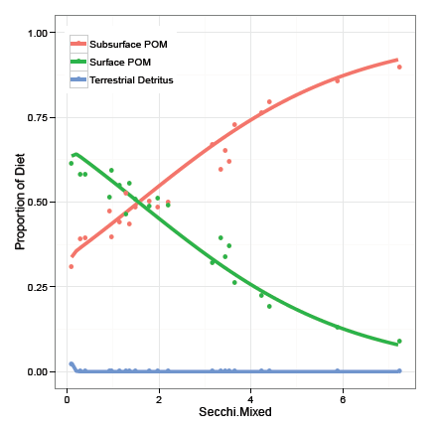
3) continuous effect
Francis et al. (2011)

Slide 17
3) continuous effect
Francis et al. (2011)

Slide 18
3) continuous effect
Francis et al. (2011)

Slide 19
3) continuous effect
Issues
Must select “Individuals as random effect”
Covariate should be standardized first
Can be finicky

Slide 20
4) Individuals as random effects
N(m_{pop},var_{group})
Recall:
Consumer δ¹³C

Slide 21
4) Individuals as random effects
N(m_{pop},var_{ind})
Now:
Consumer δ¹³C

Slide 22
4) Individuals as random effects
N(m_{pop},var_{ind})
Caution:
extreme shrinkage!
Consumer δ¹³C

Slide 23
4) Individuals as random effects
Issues
Can’t really estimate individual diets with n=1
Confounding with residual error term (choose one or the other)
Greatly increases number of parameters
Default = FALSE

Slide 24
5) hierarchy / nested

Slide 25
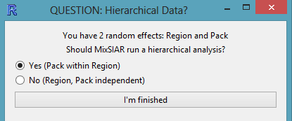
5) hierarchy / nested
Yes
No

Slide 26
5) hierarchy / nested
Look at results when Region, Pack nested vs. not

Slide 27
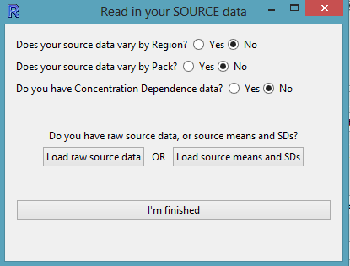
Source data options
Source by factor / effect
Concentration dependence
“Raw” or “means + SD” (+ n)

Slide 28
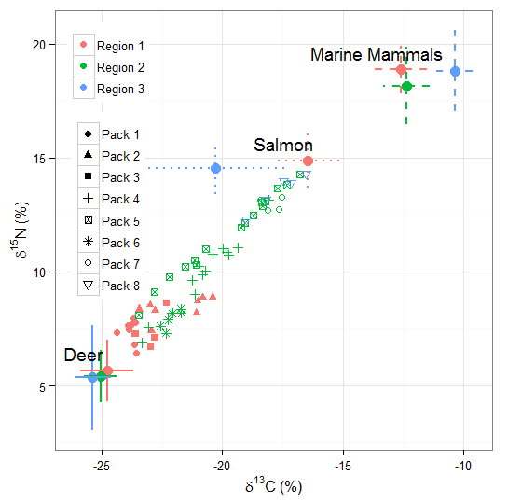
6) Source by factor

Slide 29
6) Source by factor
Yes
No

Slide 30
7) Concentration dependence
Yes
No
See Geese example

Slide 31
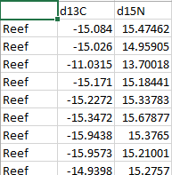
8) “Raw” or “means + SD”
“raw”
…
See Palmyra example

Slide 32
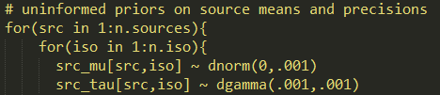
8) “Raw” or “means + SD”
“raw”
See Palmyra example

Slide 33
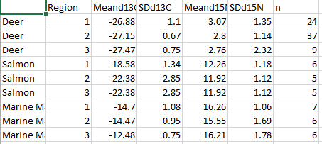
8) “Raw” or “means + SD”
“means + SD” (+ n)
See Wolves example

Slide 34
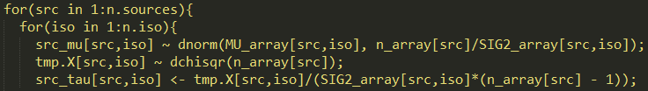
8) “Raw” or “means + SD”
“means + SD” (+ n)
See Wolves example

Slide 35
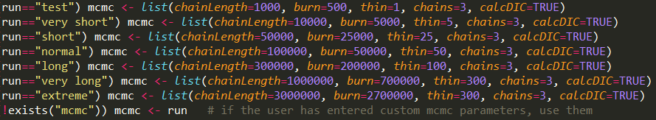
9) MCMC parameters

Slide 36
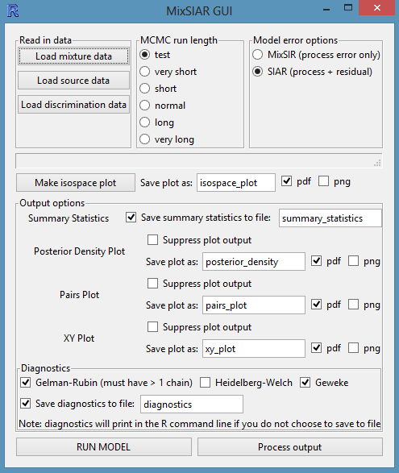
10) error structure
MixSIR
SIAR

Slide 37
10) error structure
Moore and Semmens (2008)
MixSIR
Jackson et al. (2009)
SIAR
Semmens et al. (2009)
Parnell et al. (2010)

Slide 38
10) error structure
Consumer = p₁*s₁ + p₂*s₂
(p₁ + p₂ = 1)
Source 1
Consumer
Source 2
p₁
p₂
-28
-26
-24
δ¹³C

Slide 39
10) error structure
Source 1
Consumer
Source 2
-28
-26
-24
δ¹³C

Slide 40
10) error structure
MixSIR
Source 1
Consumer
Source 2
-28
-26
-24
δ¹³C

Slide 41
10) error structure
MixSIR
Source 1
Consumer
Source 2
-28
-26
-24
δ¹³C

Slide 42
10) error structure
MixSIR
Source 1
Consumer
Source 2
-28
-26
-24
δ¹³C

Slide 43
10) error structure
Medium variance
MixSIR σ²_{process}
Source 1
Consumer
Source 2
-28
-26
-24
δ¹³C

Slide 44
10) error structure
High variance
MixSIR σ²_{process}
Source 1
Consumer
Source 2
-28
-26
-24
δ¹³C

Slide 45
10) error structure
High variance
SIAR σ²_{process} + σ²_{resid}
Source 1
Consumer
Source 2
-28
-26
-24
δ¹³C

Slide 46
10) error structure
High variance
SIAR σ²_{process} + σ²_{resid}
Source 1
Consumer
Source 2
-28
-26
-24
δ¹³C

Slide 47
10) error structure
Low variance
SIAR σ²_{process} + σ²_{resid}
Source 1
Consumer
Source 2
-28
-26
-24
δ¹³C

Slide 48
10) error structure
Low variance
ε < 1
MixSIAR σ²_{process} * ε
Source 1
Consumer
Source 2
-28
-26
-24
δ¹³C

Slide 49
10) error structure
High variance
ε > 1
MixSIAR σ²_{process} * ε
Source 1
Consumer
Source 2
-28
-26
-24
δ¹³C

Slide 50
10) error structure
MixSIR σ²_{process}
SIAR σ²_{process} + σ²_{resid}
MixSIAR σ²_{process} * ε
(not yet)
Issues:
Default = SIAR (+ residual)
Do not include both SIAR error and “Indiv as RE”
NOTE: must include “Indiv as RE” for continuous effect
MixSIR error may be slightly better than SIAR for small variance

Slide 51
Happy mixing!
b1stock@ucsd.edu

